Slide 1
Css selectors Elements flow Pseudo elements & classes Box model
Kyrylo Abramov

Slide 2
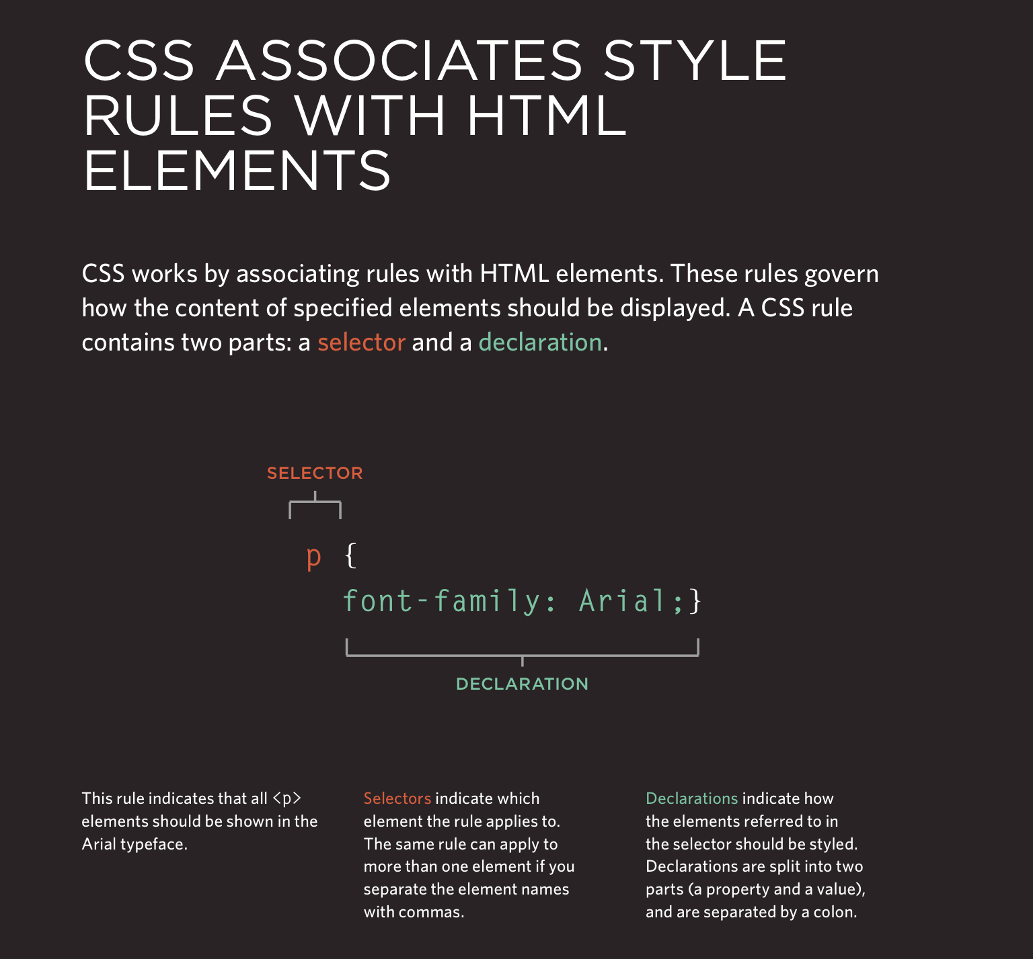
CSS Selectors
CSS selectors types
Cascad
Specificity
Inheritance

Slide 3
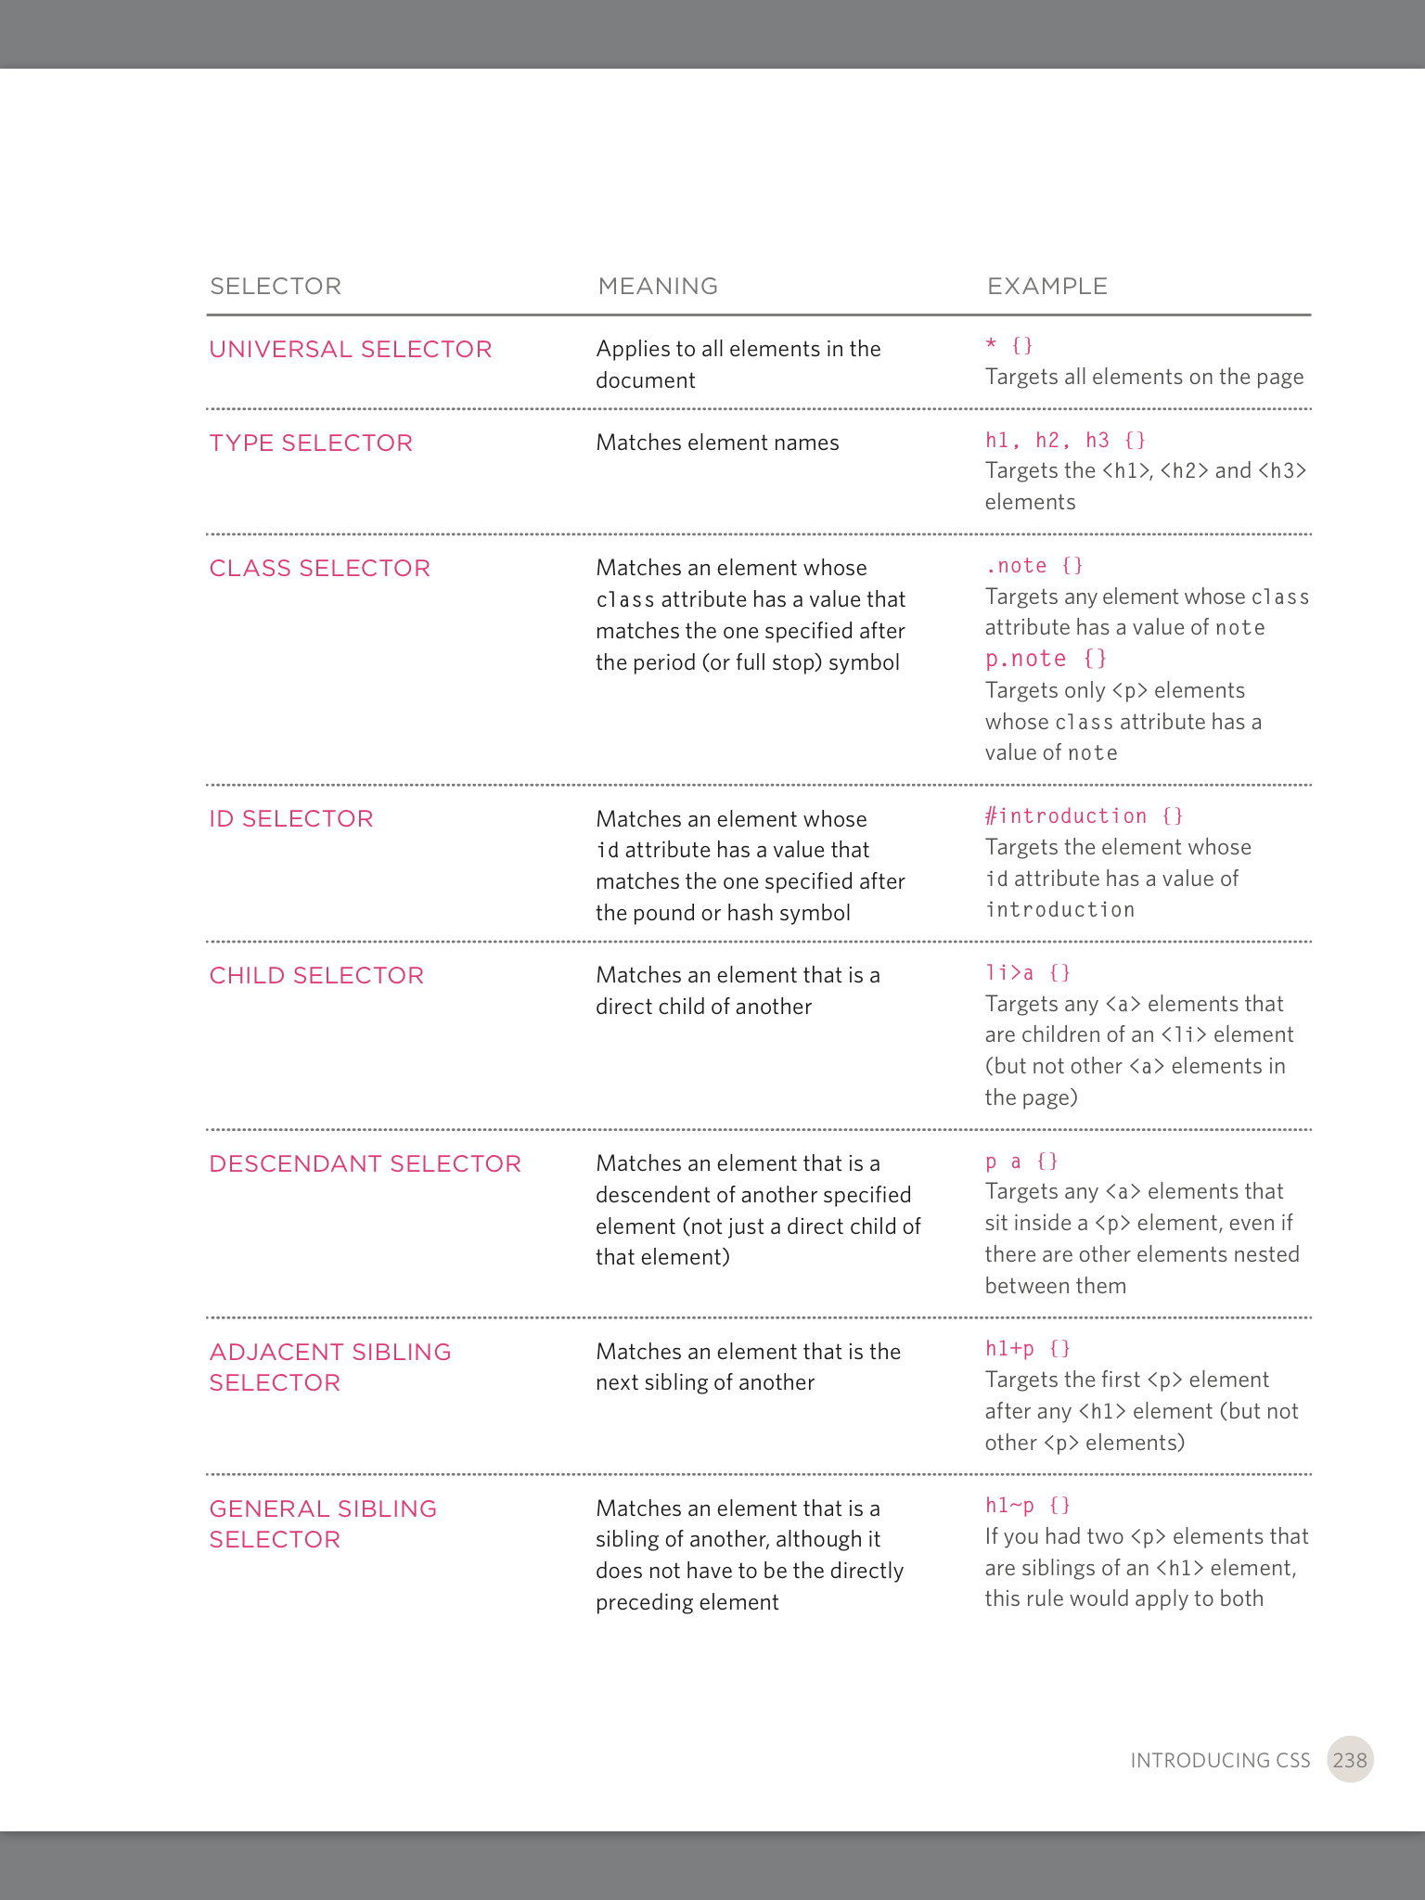
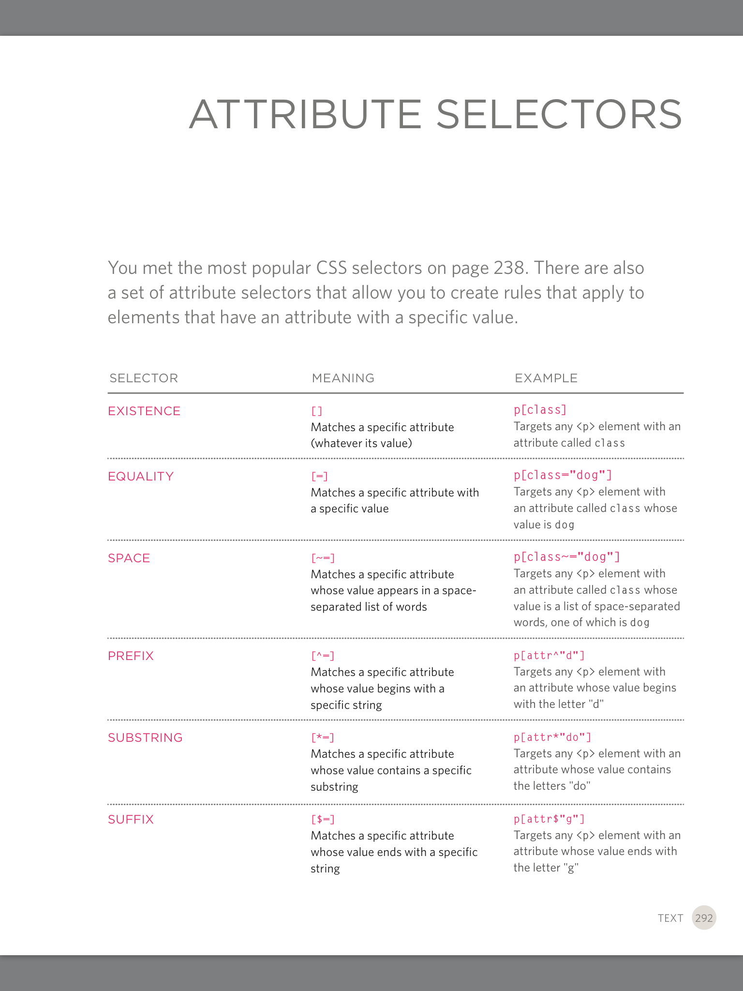
Selectors allows us to target one or more rules to one or more specific elements in an HTML doc.

Slide 4
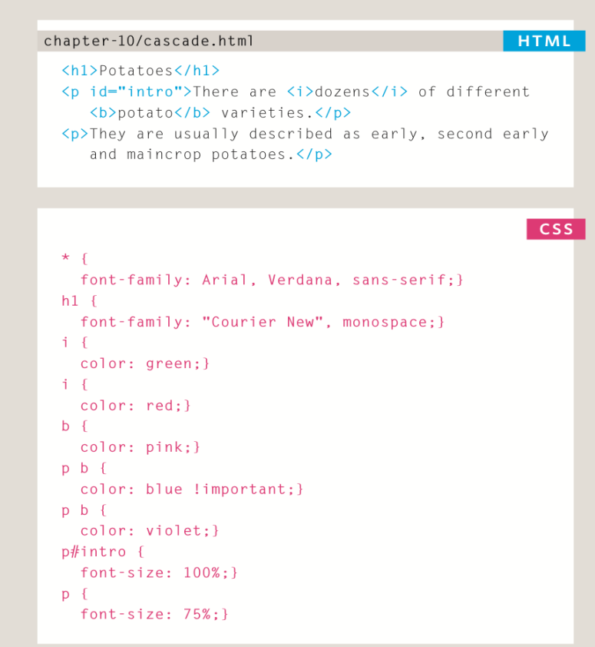
Cascad concept
Cascad – is a fundamental concept of CSS.
Is the process or algorithm that determines the properties aplied to each element on the page.
It does so taking in consideration:
SPECIFICITY
IMPORTANCE
INHERITANCE
ORDER IN FILE
Last rule:
If two selectors are identical, the latter of two will take precedance.
Specificity:
If one selector is more specific than the others the more specific rule will take precedence over more general one.
!Important:
Adding !Important after any property value to indicate that it should be considered more important than other rules that apply to the same element

Slide 5
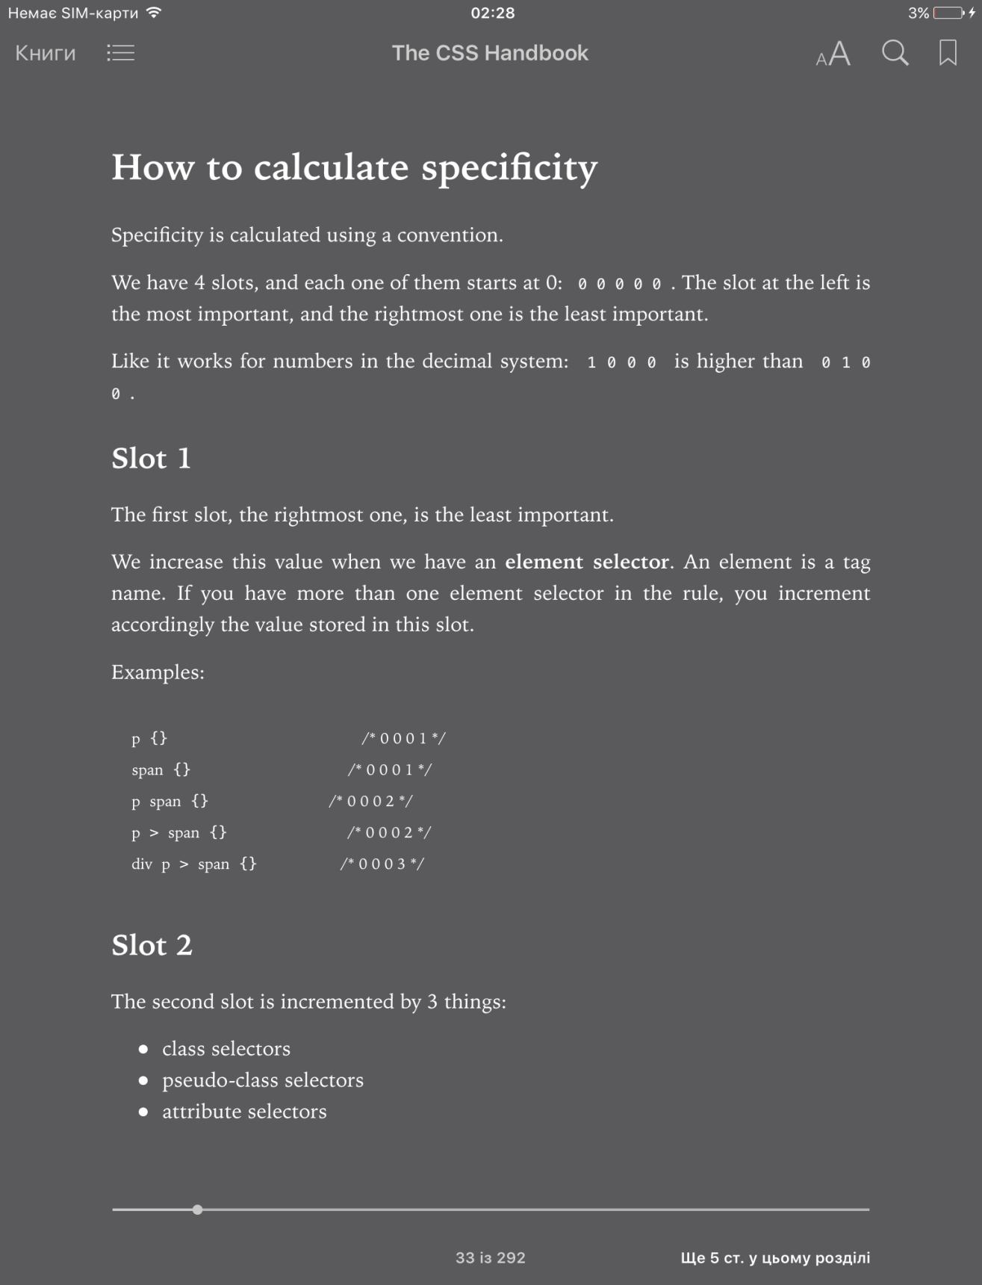
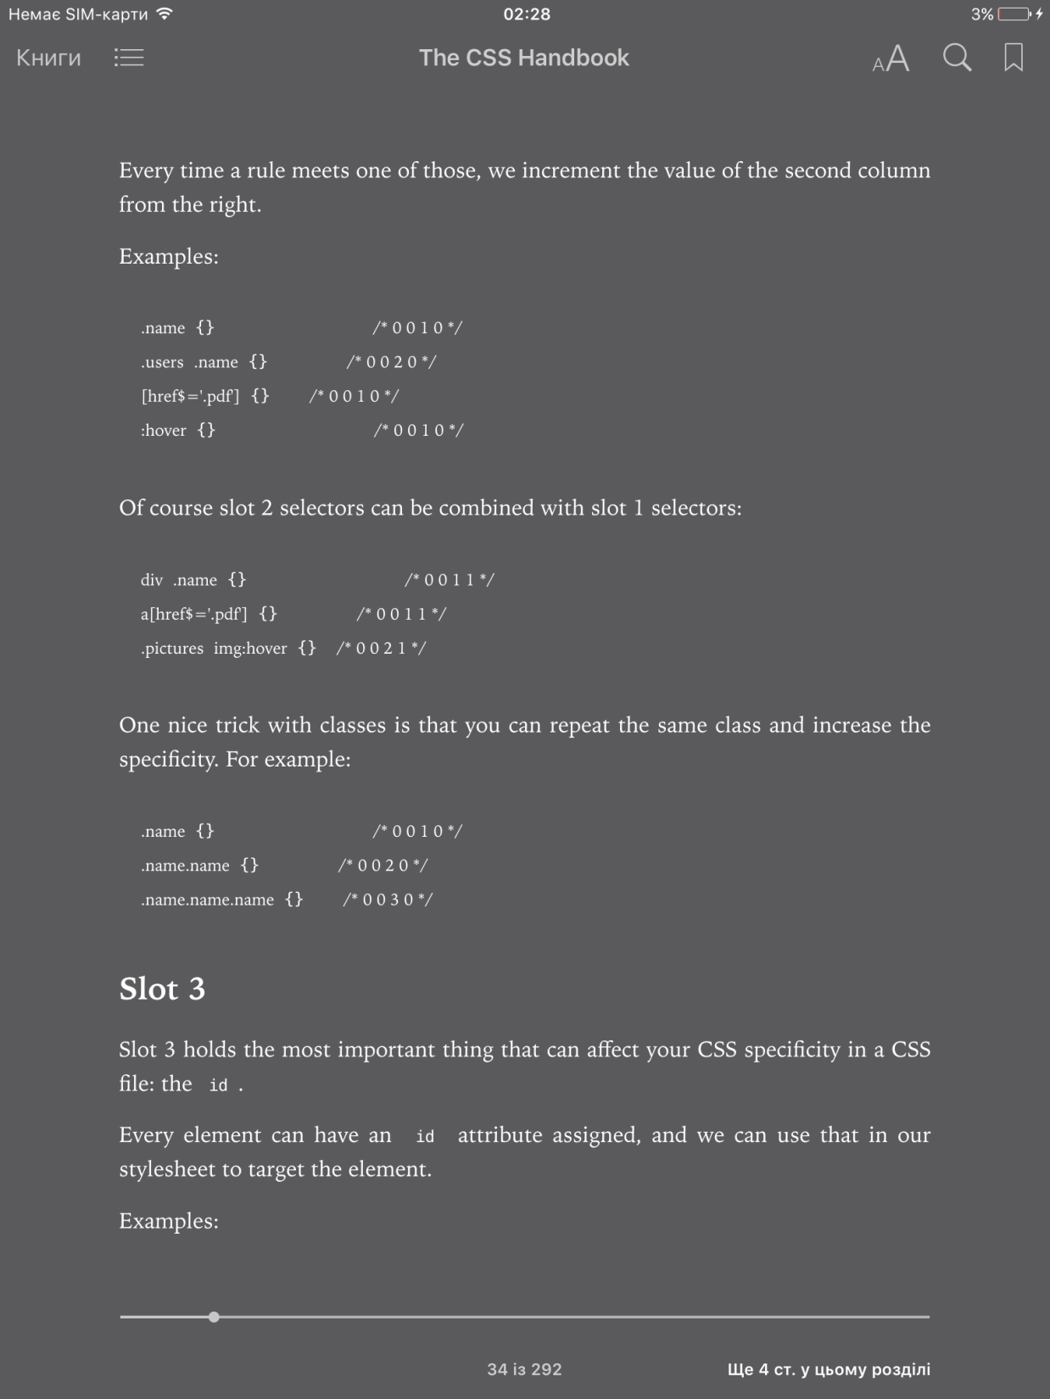
Calculating Specificity

Slide 6
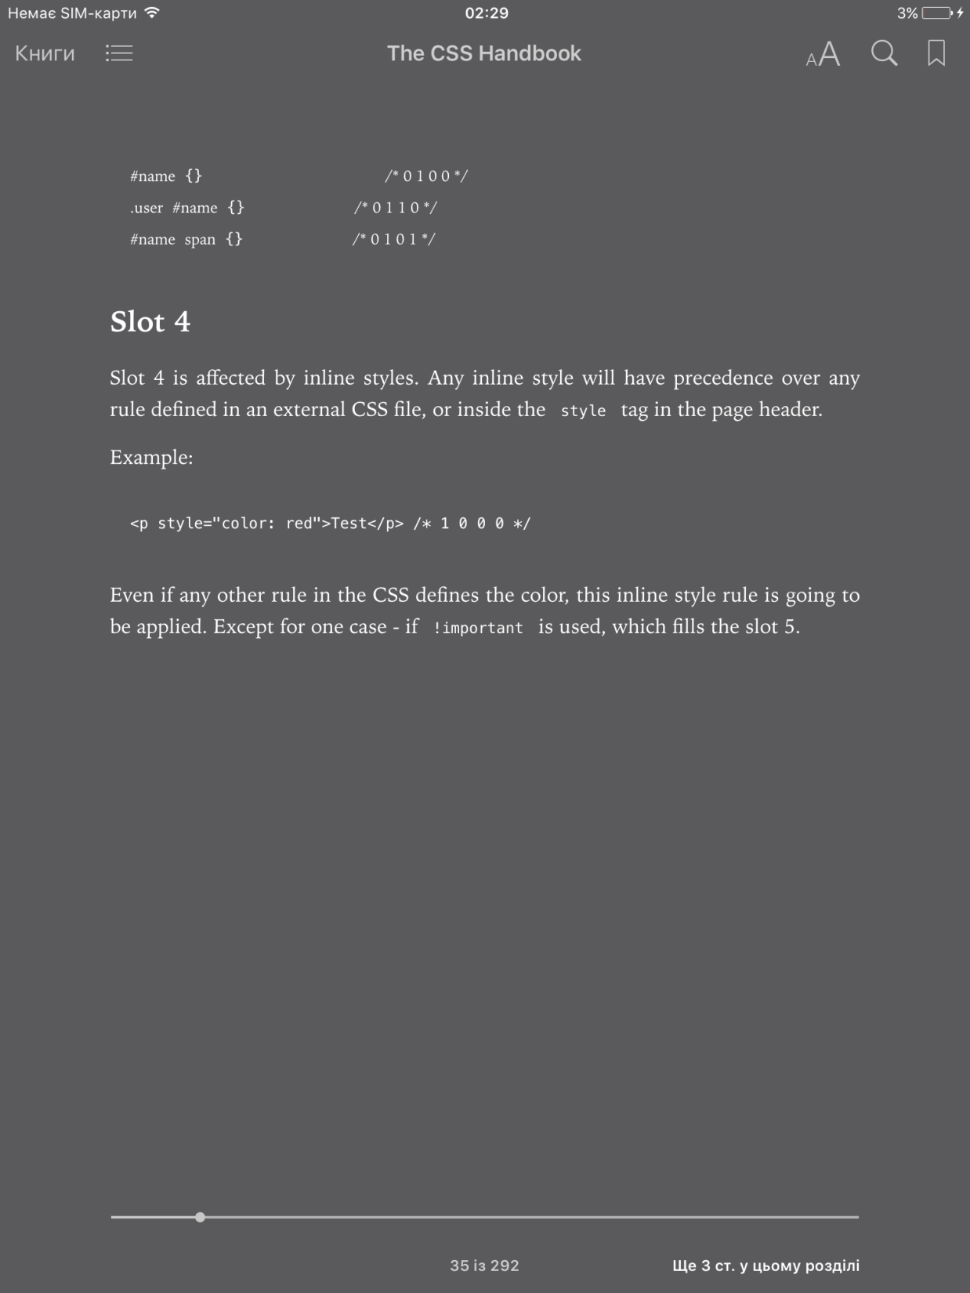
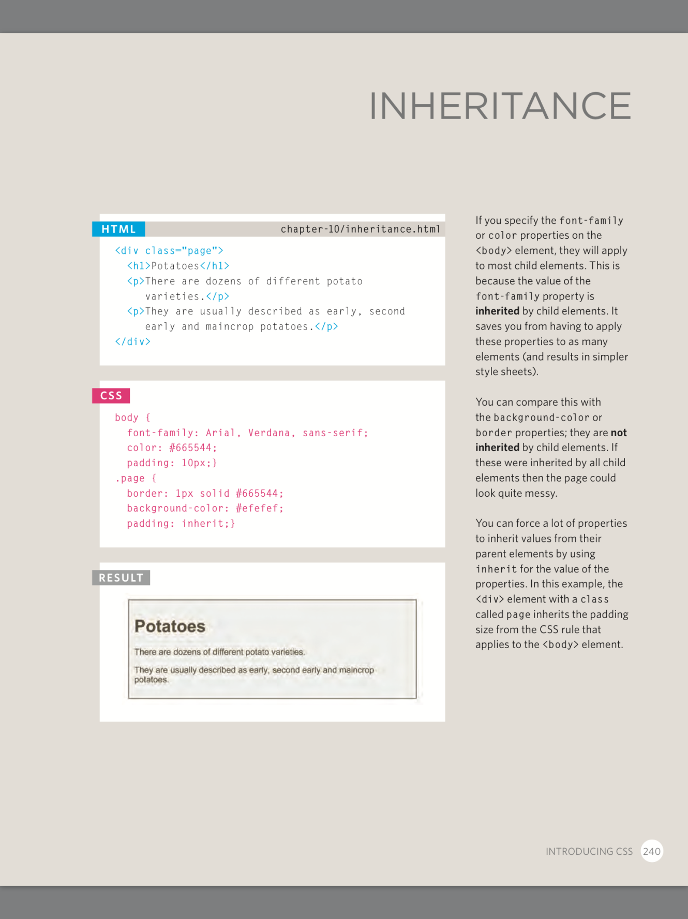
Inheritance

Slide 7
TIPS
Use the amount of specificity you need but no more. In this way, you can craft other selectors to overwrite the rules set by preceding rules without going mad.
!Important is a highly debated tool. Many CSS experts advocate against using it. Use it when it is extremely necessary, but in general, avoid.
Using the id to style CSS is also debated a lot, since it has a very high specificity. A good alternative is to use classes instead which have less specificity, are easier to work with and are more powerful and reusable.

Slide 8
Pseudo Elements & Classes
Definition
Syntax
Usage

Slide 9
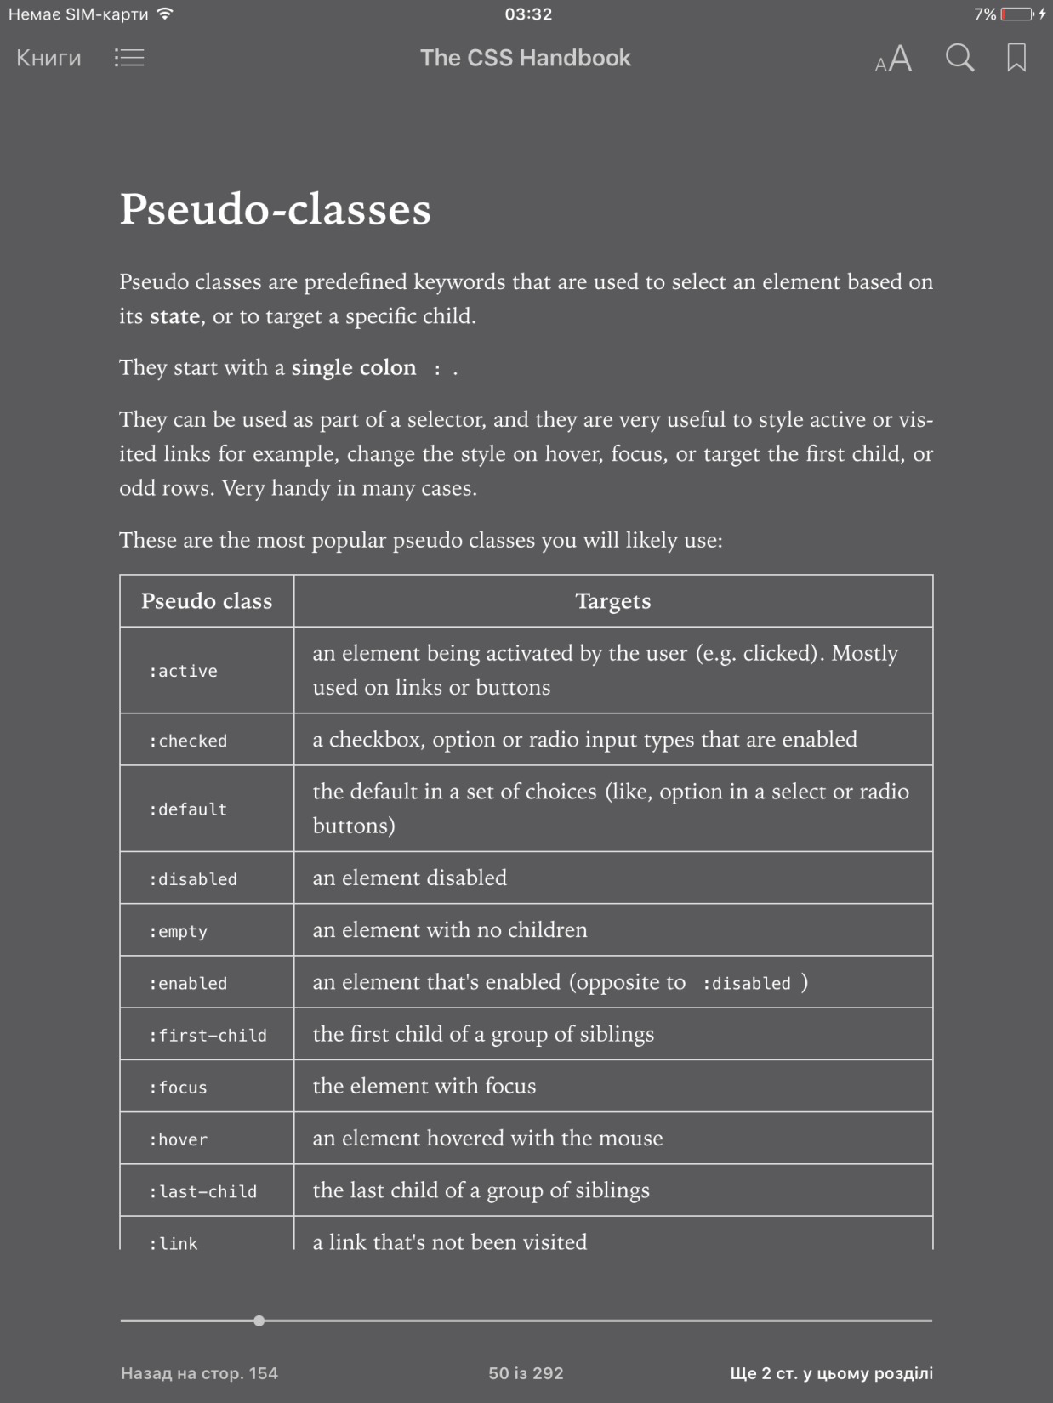
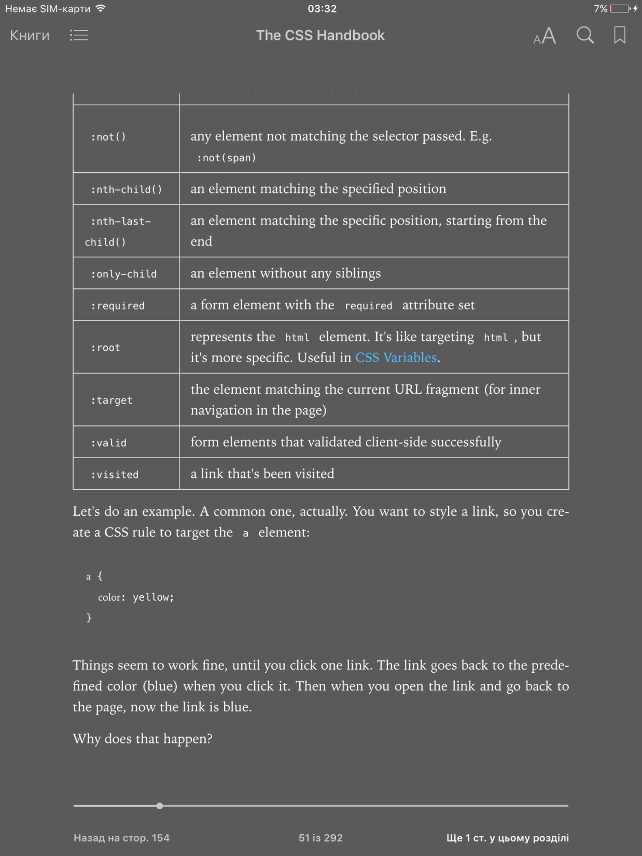
Pseudo classes are predefined keywords that are used to select an element based on its state, or target a specific child.
selector:pseudo-class {property: value}

Slide 10
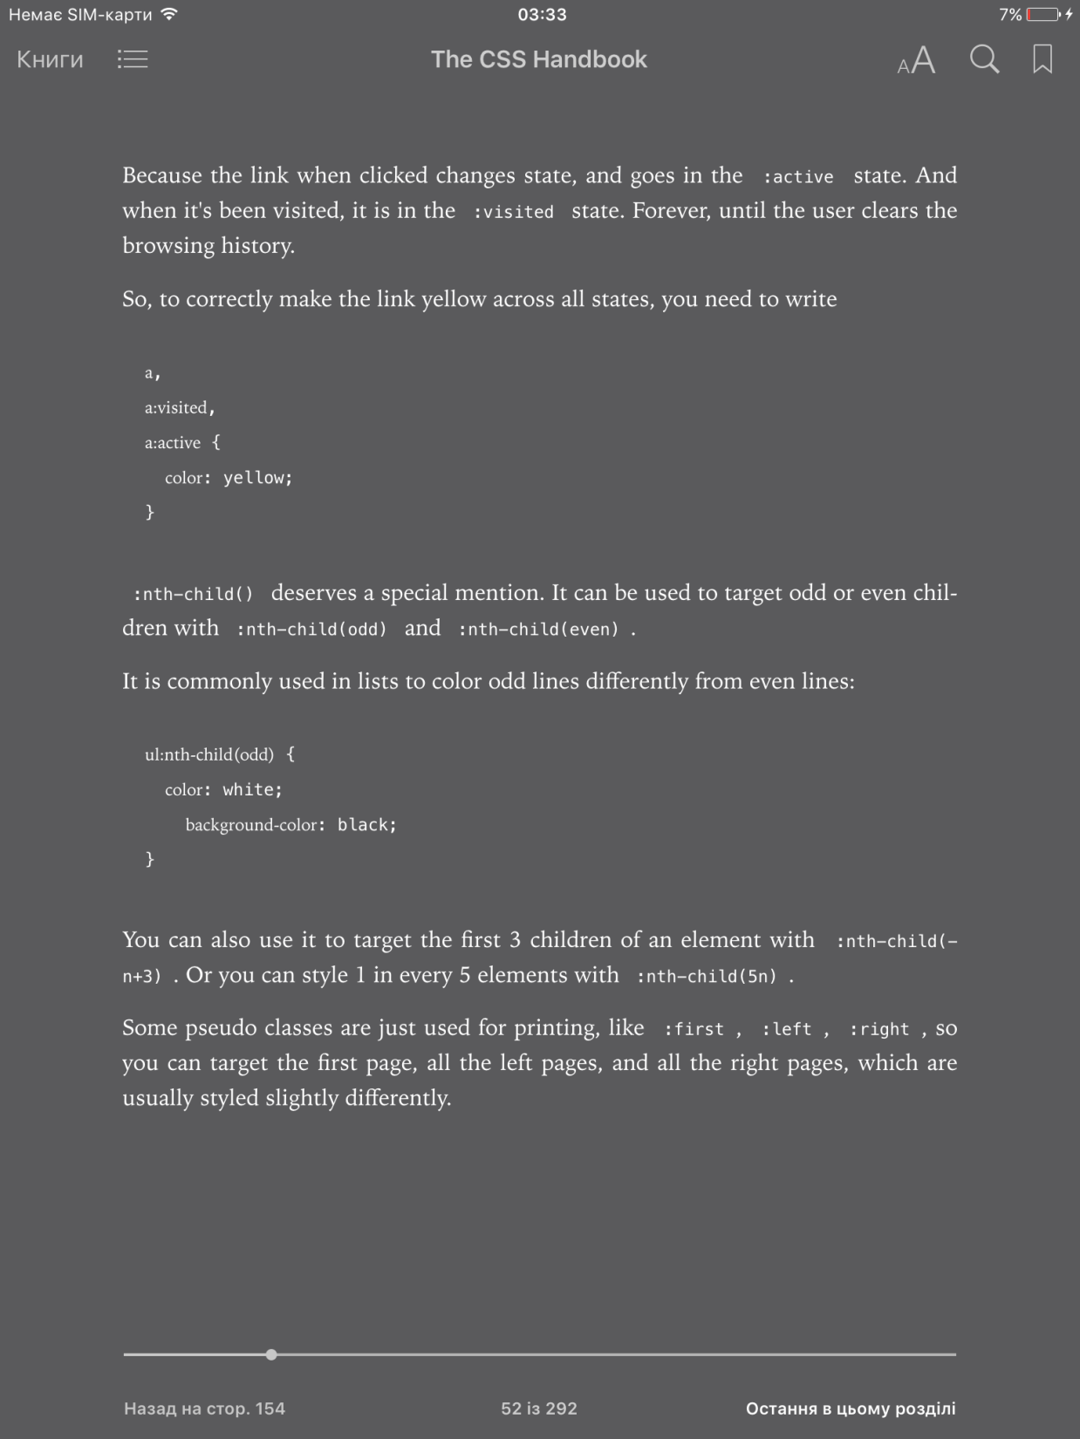
Usage
a:link
a:visited
a:hover
a:active

Slide 11
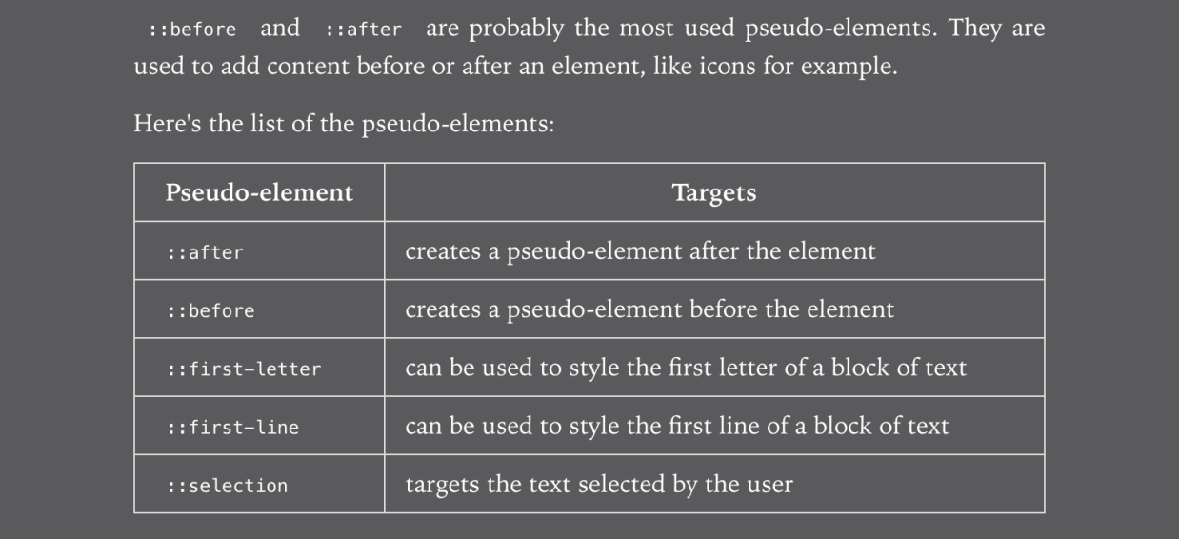
Pseudo-elements are used to style a specific part of an element.
selector::pseudo-class {property: value}

Slide 12
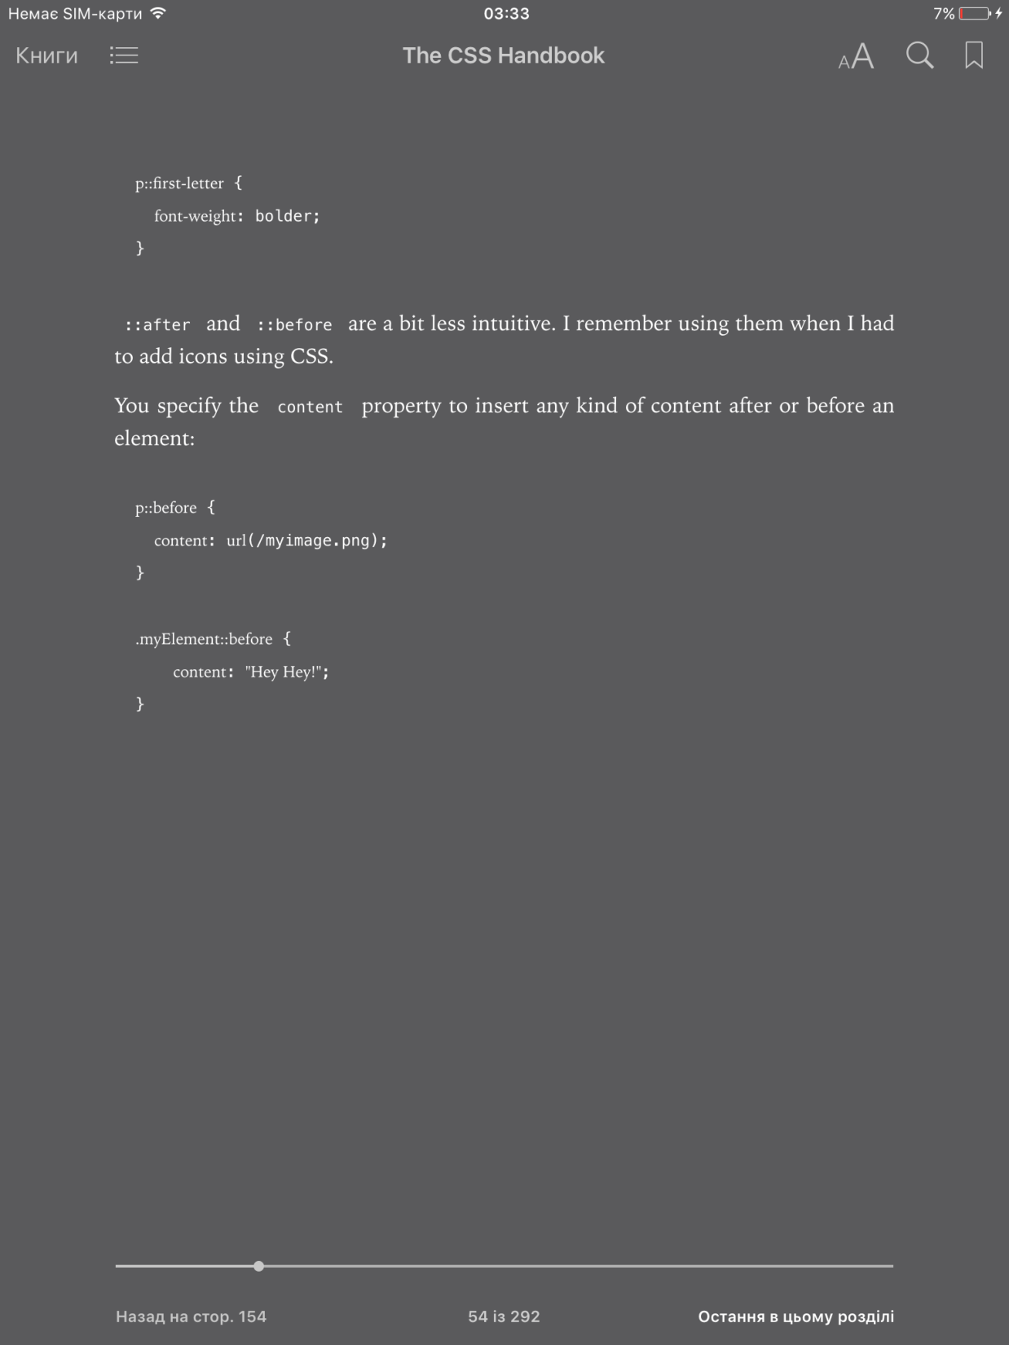
Usage

Slide 13
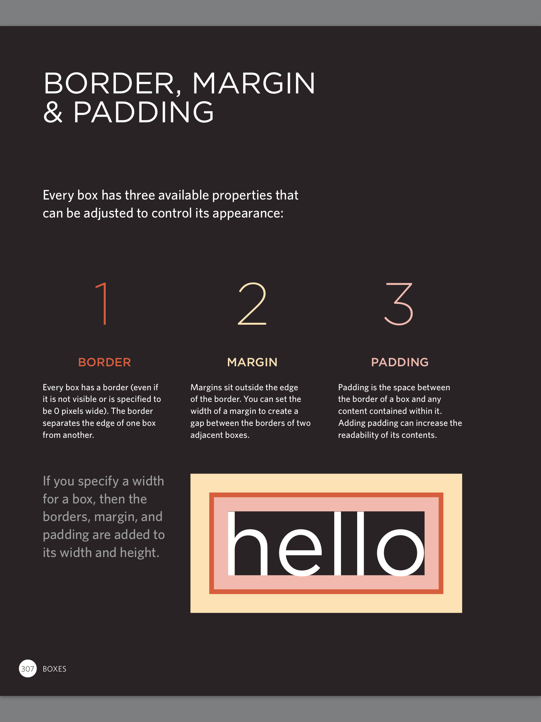
BOX-MODEL
Definition
Properties
Usage

Slide 14
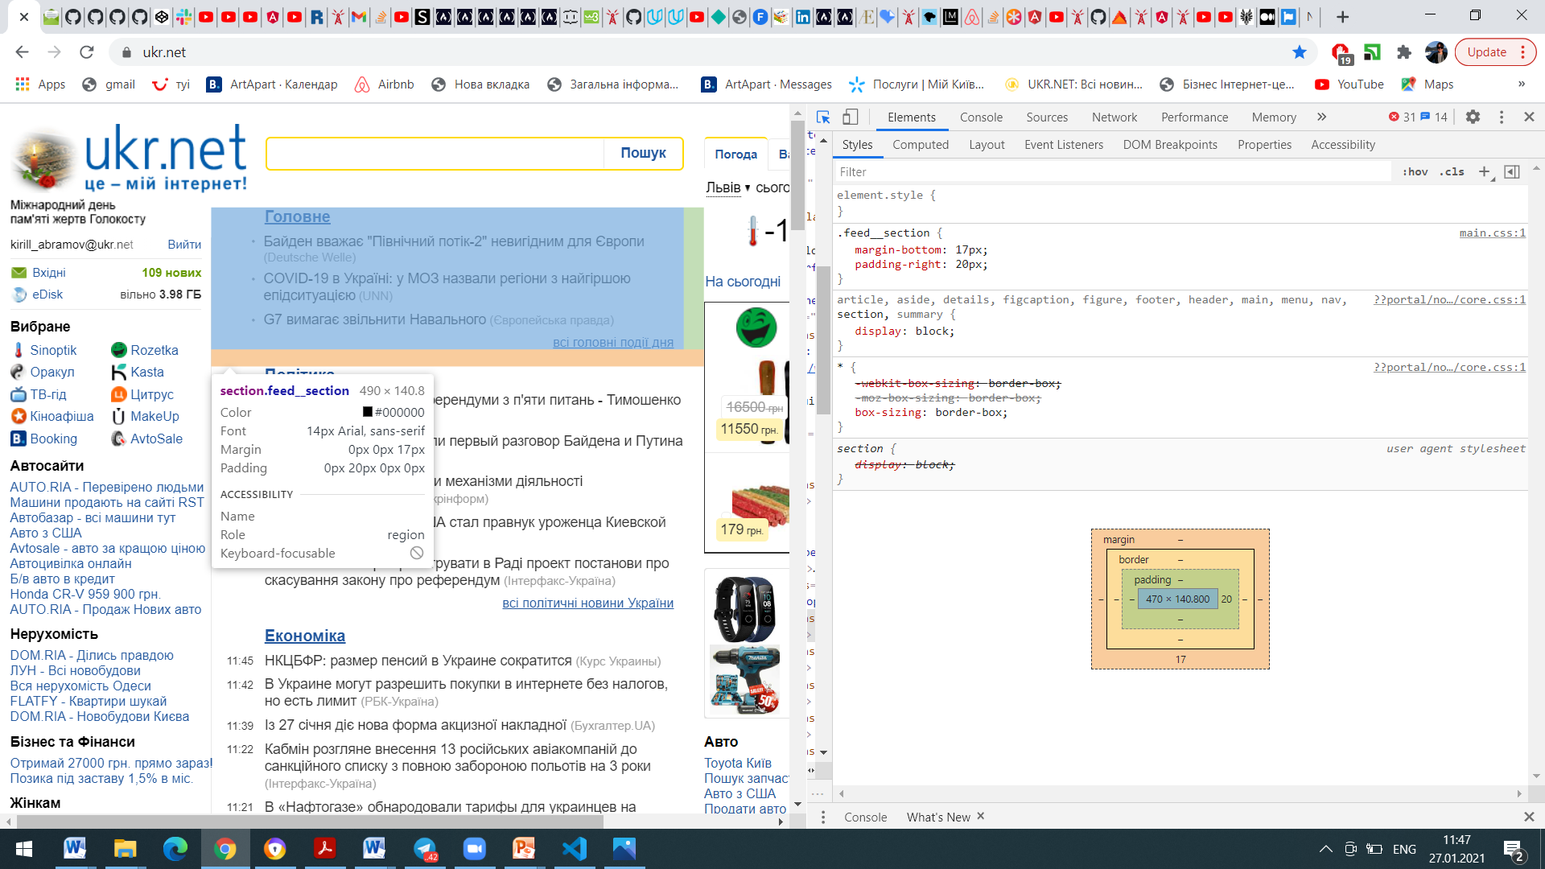
BOX-MODEL
Every HTML element is essentially a box.
Box model explains the sizing of the elements based on CSS properties.
From inside to outside we have:
Content area (blue)
Padding (green)
Border (black)
Margin (pink)

Slide 15
BOX-MODEL

Slide 16
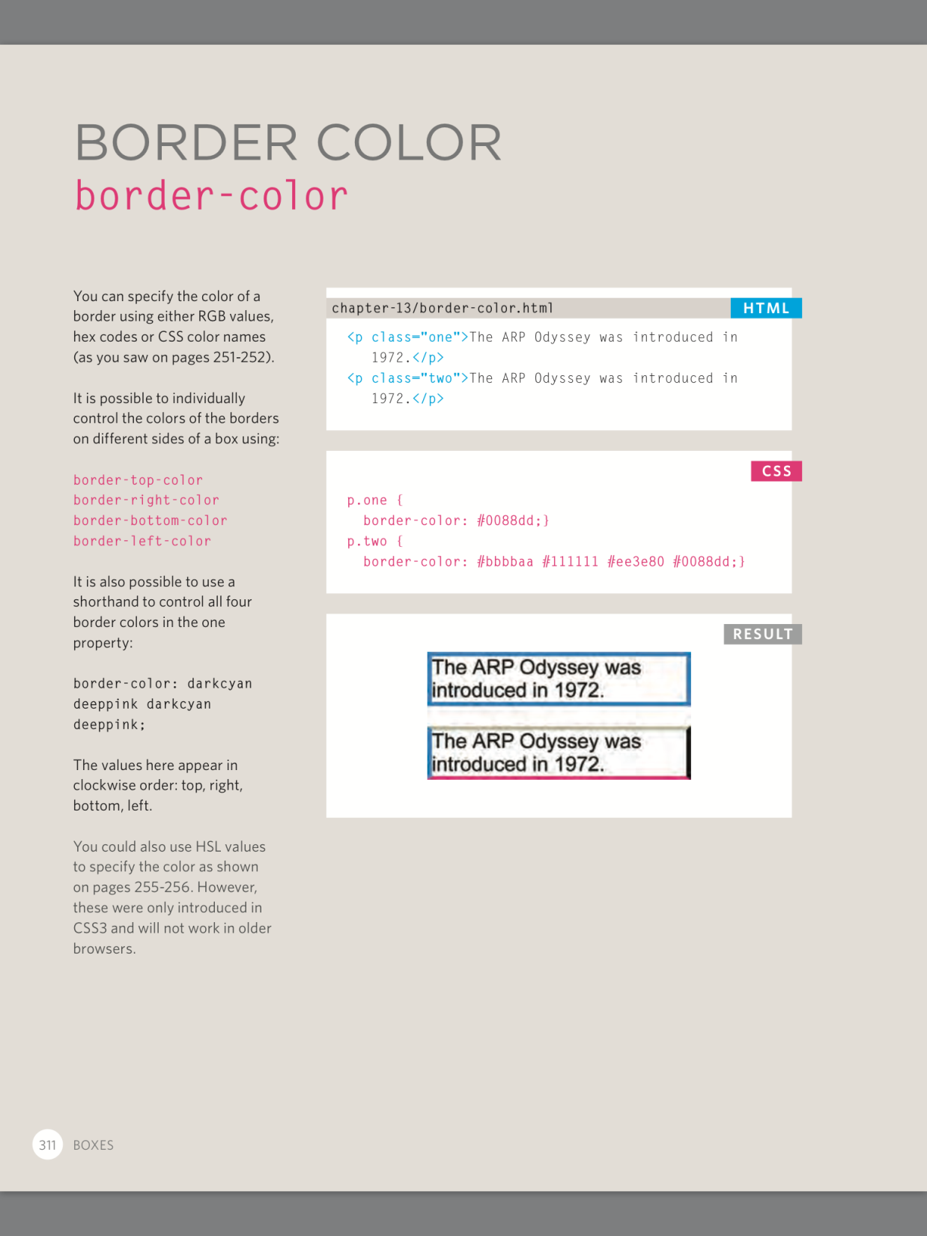
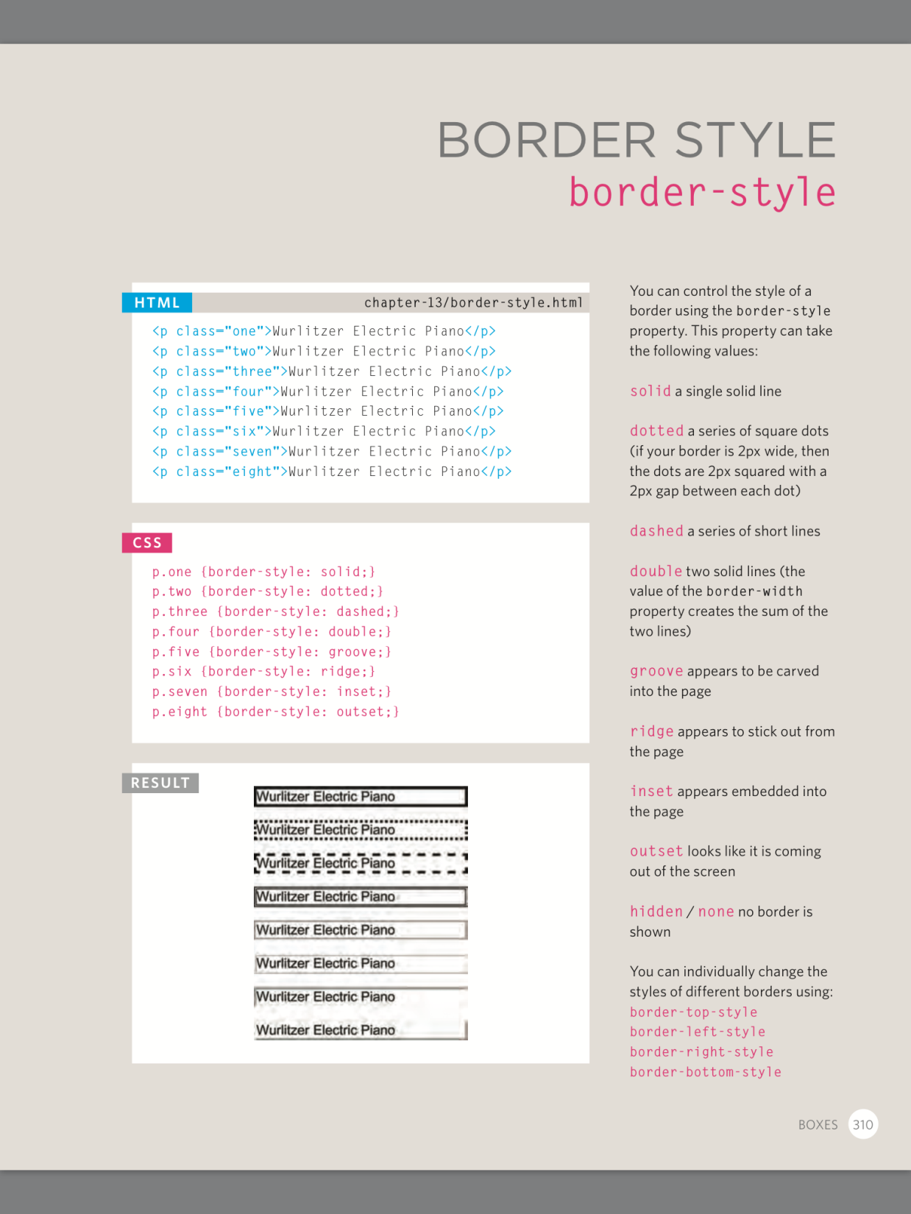
BORDER
Border width:
Thin
Medium (default)
Thick OR in px, rem, em…

Slide 17
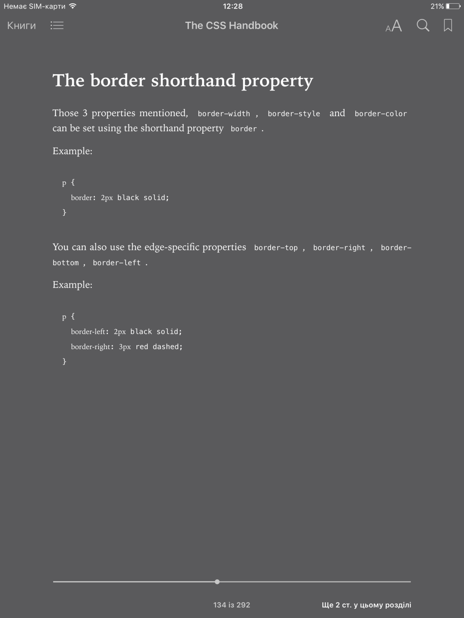
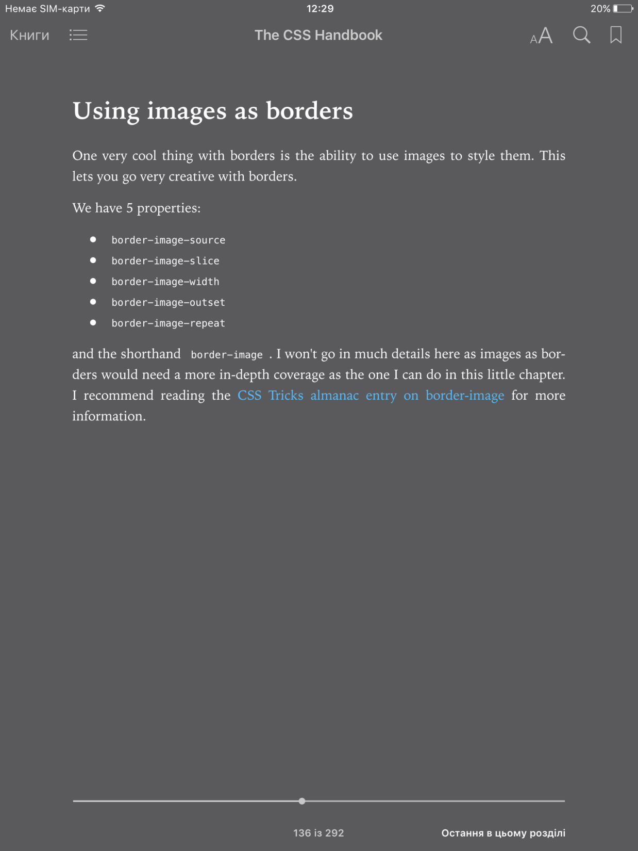
BORDER syntax

Slide 18
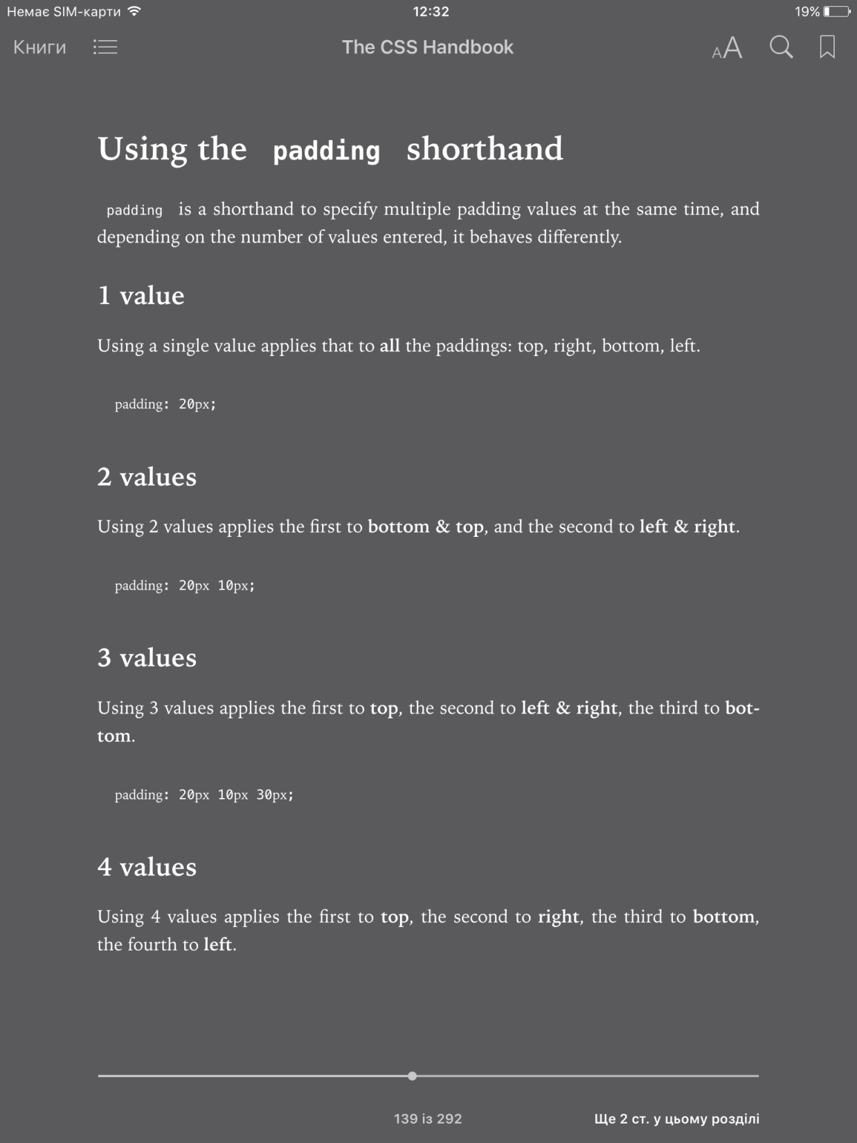
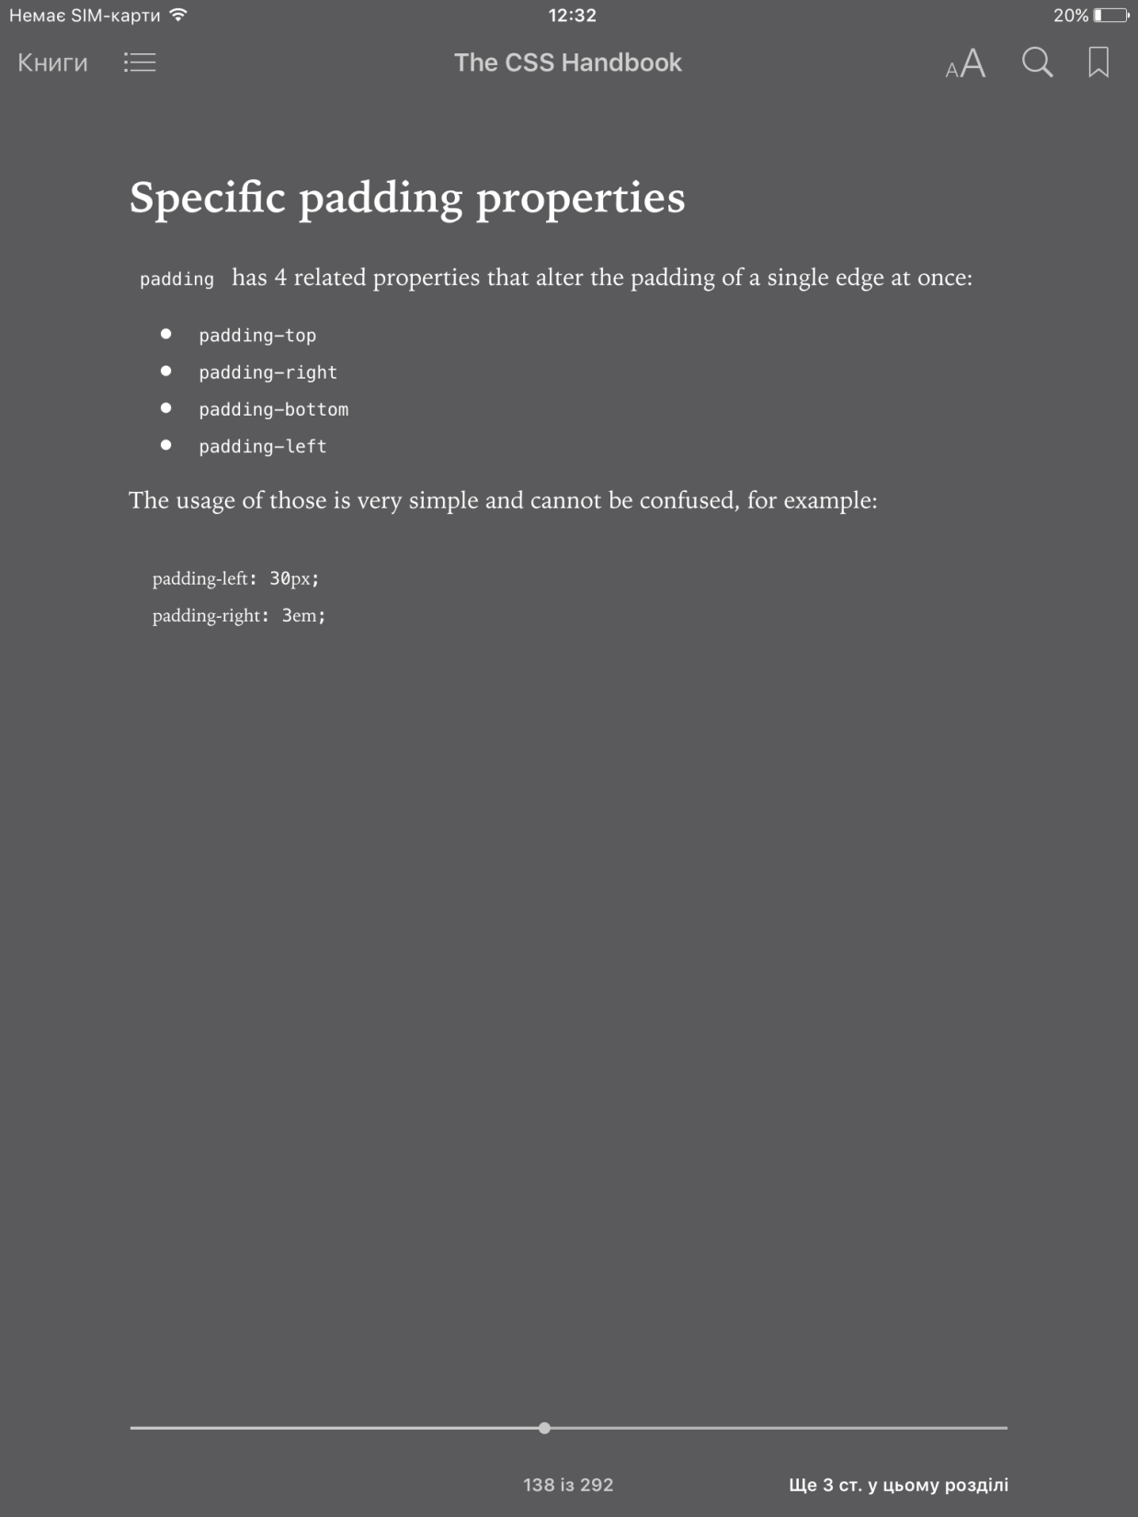
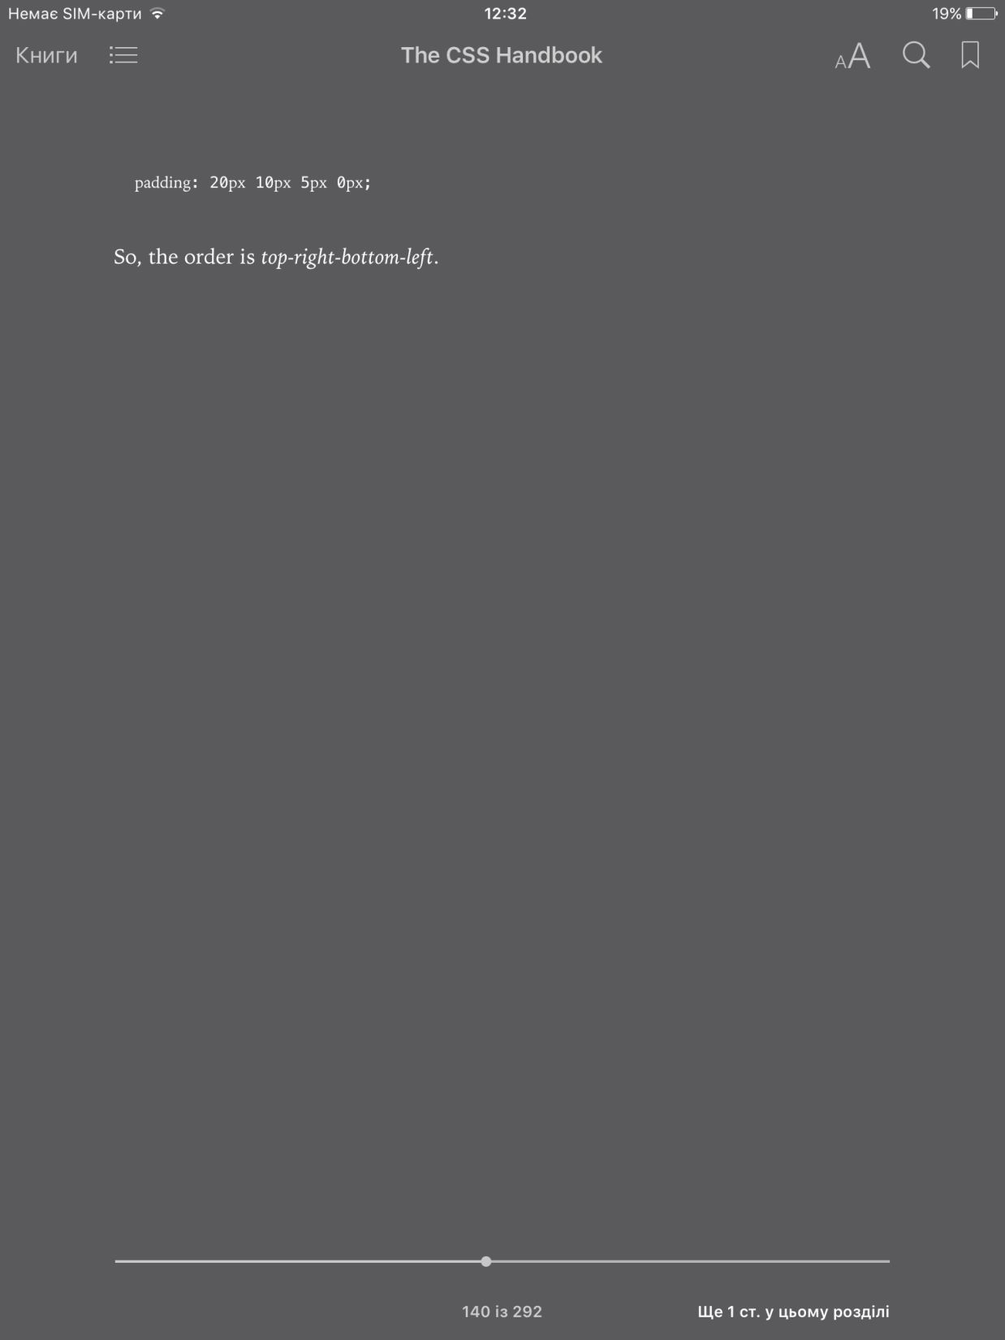
PADDING

Slide 19
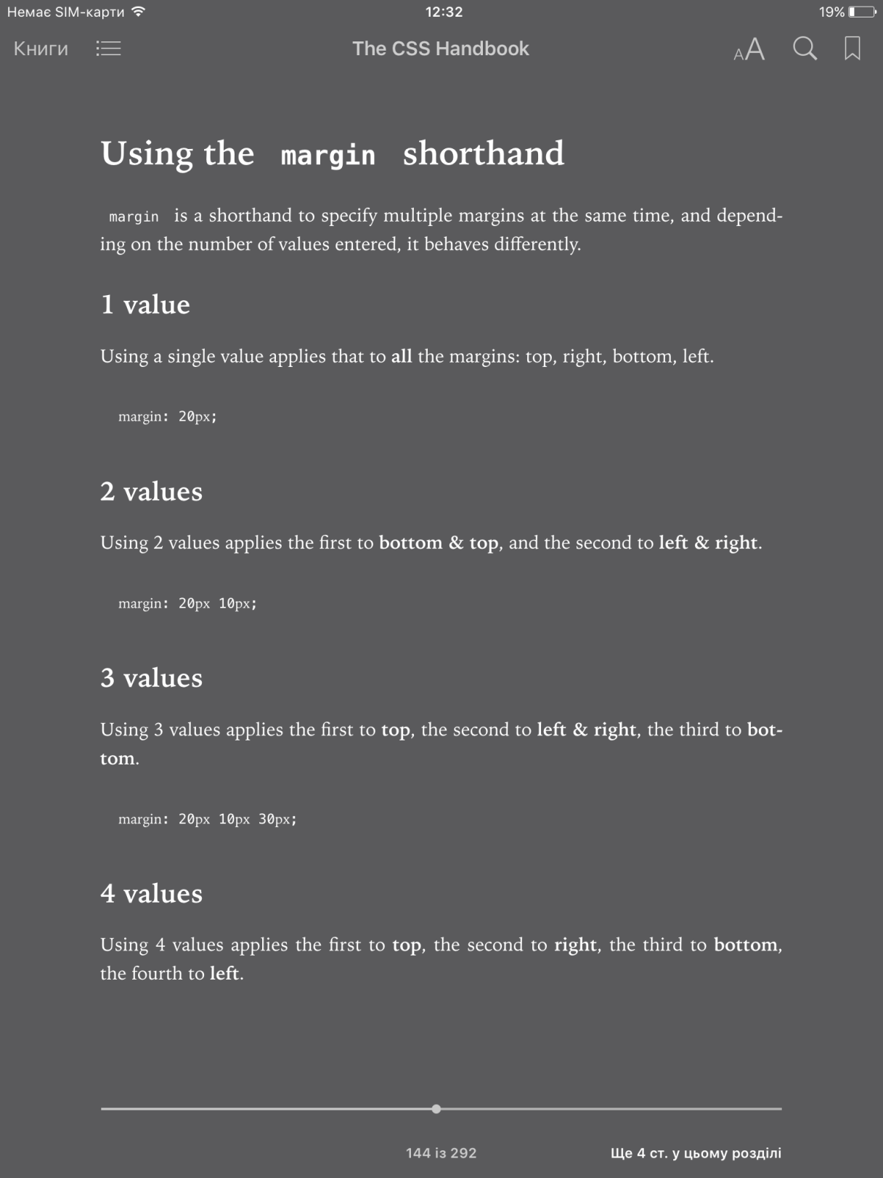
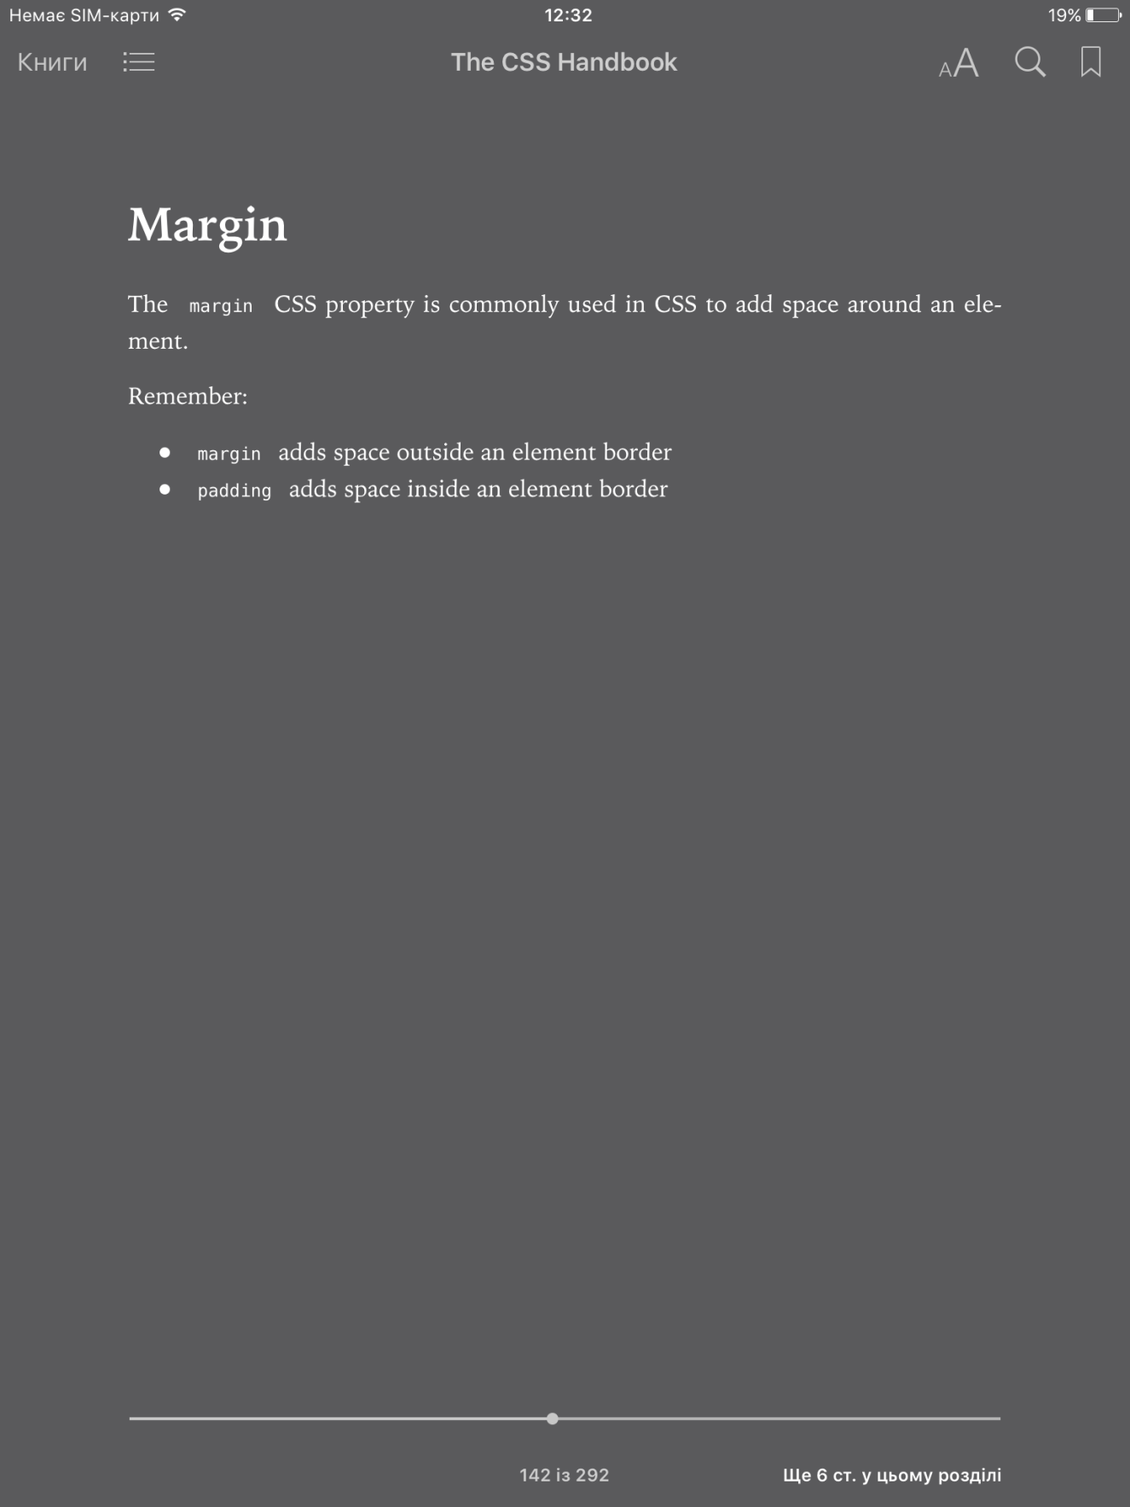
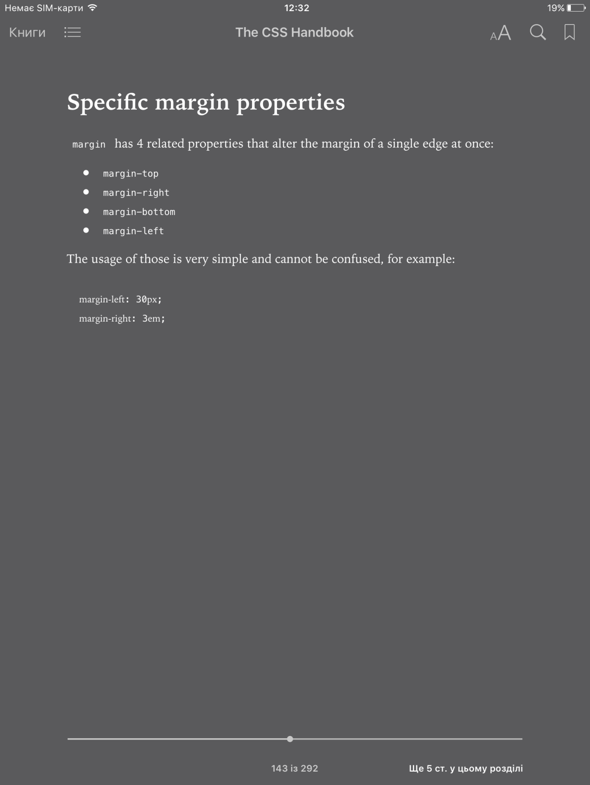

MARGIN

Slide 20
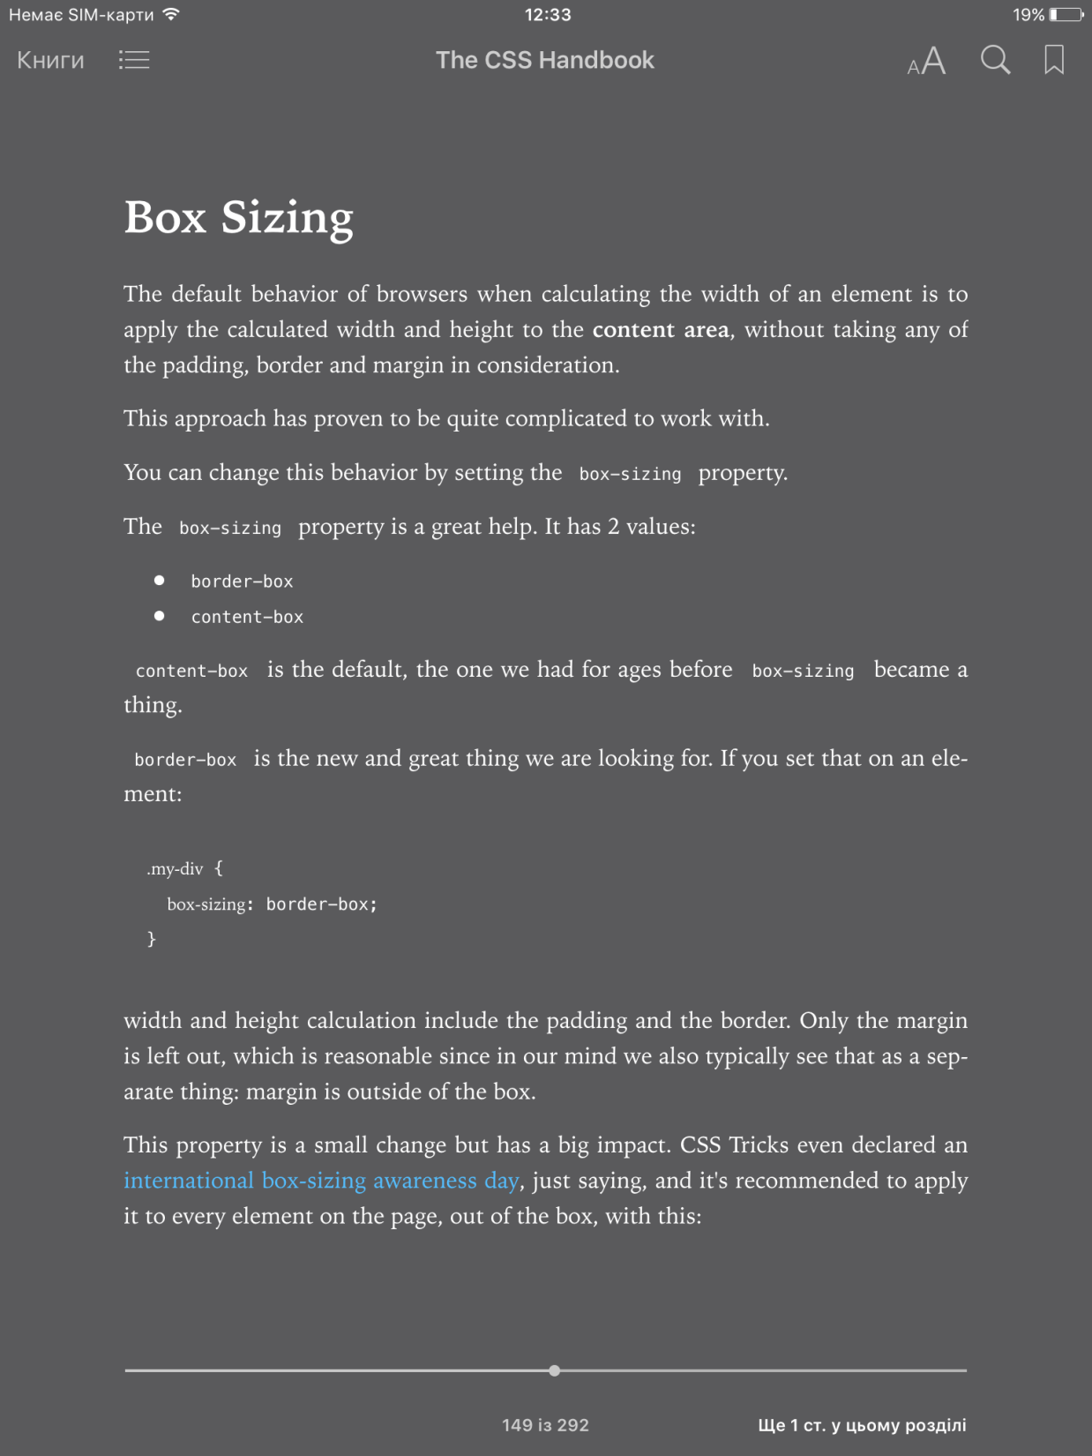
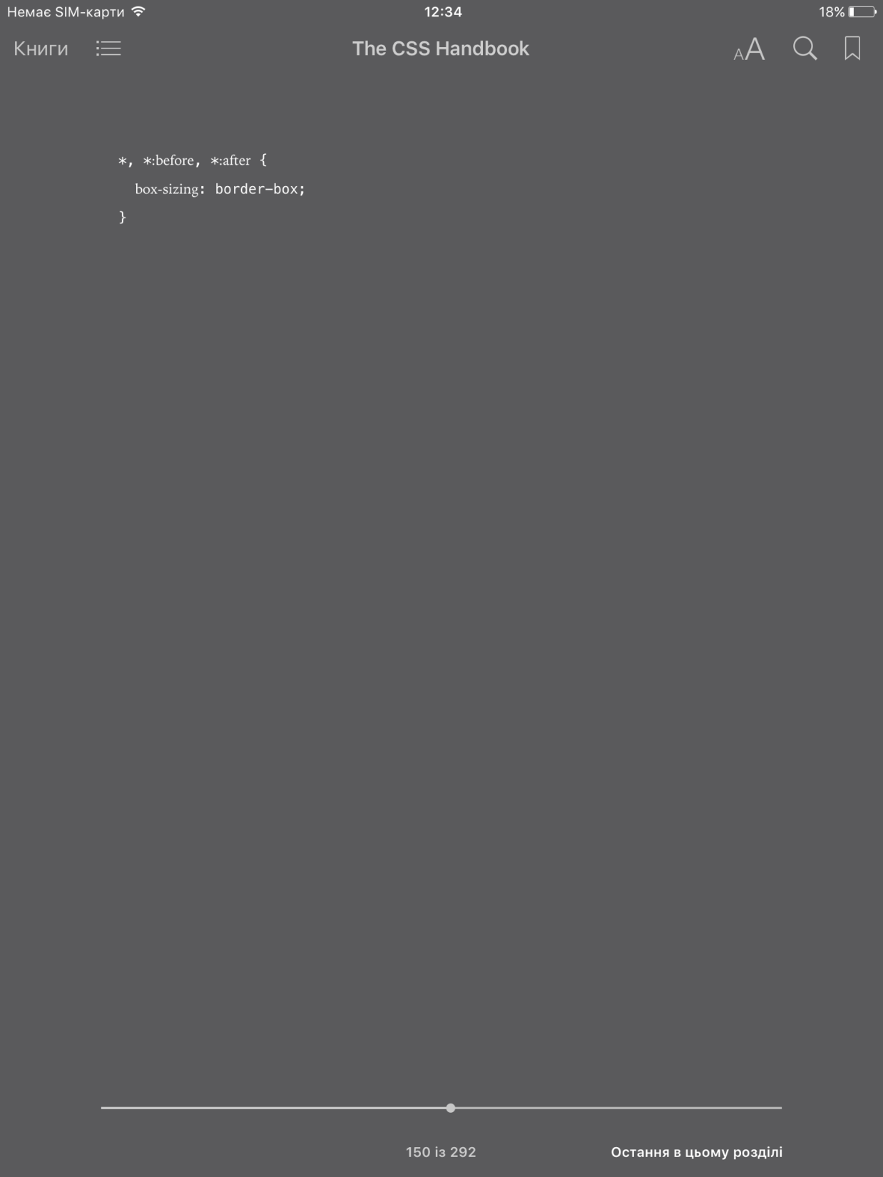
BOX-SIZING

Slide 21


